Slide 1
Optical Networks [EENGM0003]
Dr. George T. Kanellos
[gt.kanellos@bristol.ac.uk]
Notes:
Joined july
HPN group
background

Slide 2
Optical Networks unit: Main outcomes
Networks requirements for supporting current, emerging and future Internet applications
Different types of modern optical networks
State-of-the-art and emerging optical network transport technologies
Modern techniques and mechanism for control and managements of optical networks
Complementary to
Optical Communications Systems and Data Networks | EENGM2001
Notes:
I know your Background is Optoelectronic Devices and Systems (M)
In this unit we will be dealing on applying these technologies

Slide 3
Outline of the course
Session1 (Jan. 25): Introduction to modern optical networks
Session2 (Feb.1): Fundamental optical network technologies and topologies
Session3 (Feb.8): Introduction to Wavelength Division Multiplexing (WDM)
Session4 (Feb.15): WDM Network topologies
Session5 (Feb.22): Advanced WDM routing
Session6 (Mar.8): Higher order modulation formats
Session7 (Mar.15): Elastic networks and Sub-wavelength Optical networks
Session8 (Mar.22): Client layers of optical networks
Session9 (Mar.29): Optical network control and management
Session10 (Apr 26): Optical network security and quantum networking
Session11 (May 3): revision class

Slide 4
assessment methods
1 Formative assessment/ related to the lab
Summative Assessment
100% final Exam
All information will be available to Blackboard

Slide 5

Reading material
Textbook (required): Optical Networks: A Practical Perspective , Rajiv Ramaswami, Kumar Sivarajan, and Galen Sasaki, , 3rd Edition, Morgan Kaufman Publishers, 2009
Textbook (required): Optical WDM Networks, Biswanath Mukherjee, Springer, 2006
Texbook: Enabling Optical Internet with Advanced Network Technologies, Javier Aracil, Franco Callegati, Springer, 2009
Textbook: Advanced Optical Communication Systems and Networks, Artech House, 2013
Textbook: Next Generation Transport Networks: Data, Management, and Control Planes,Manohar Naidu Ellanti, Springer, 2005
Textbook: IP over WDM: Building the Next Generation Optical Internet, Sudhir Dixit, Wiley , 2003
Textbook: Optical Network Control: Architecture, Protocols, and Standards, Greg Bernstein, Bala Rajagopalan, Debanjan Saha, Addison Wesley, 2004

Slide 6
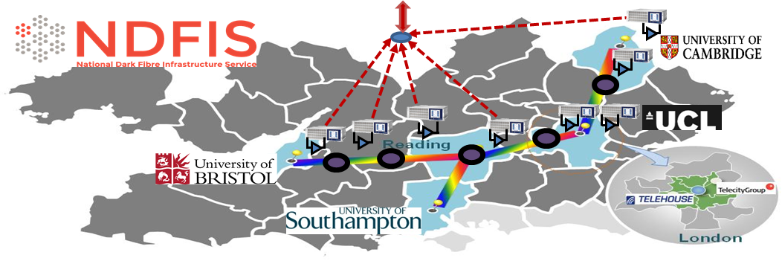
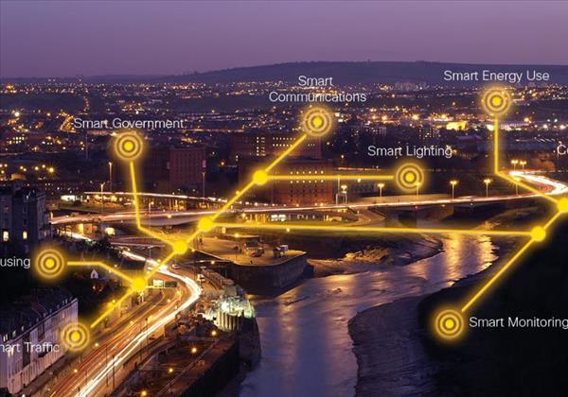
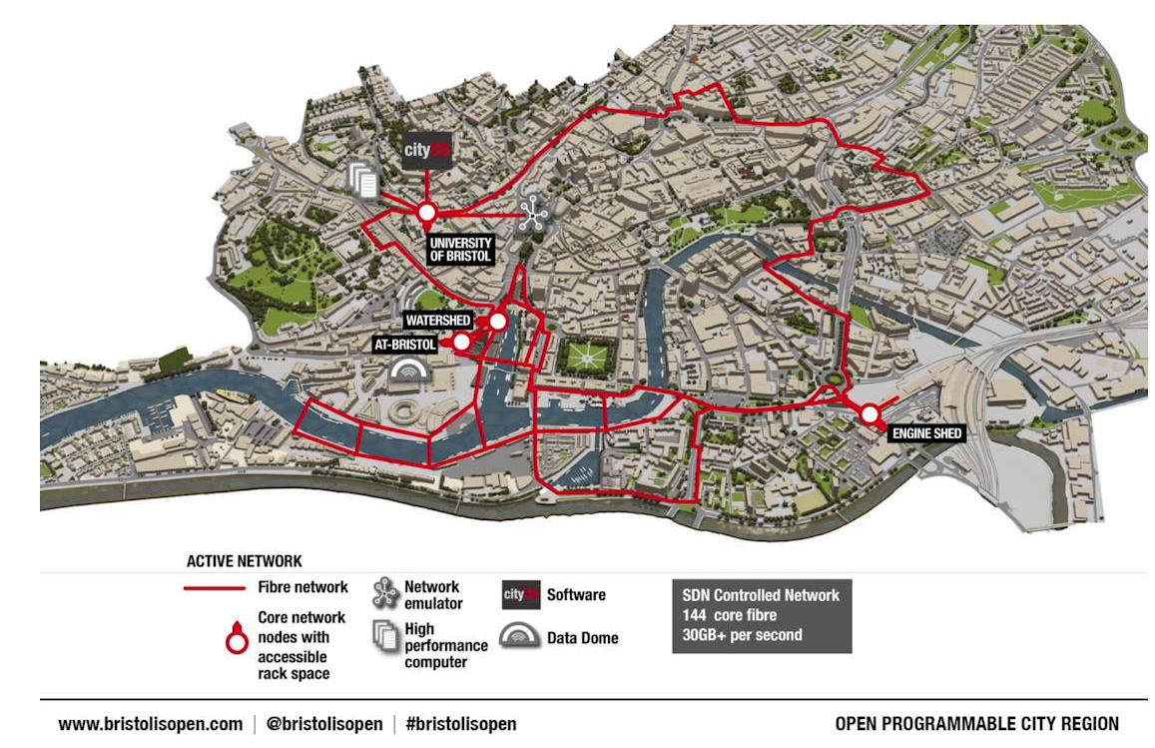
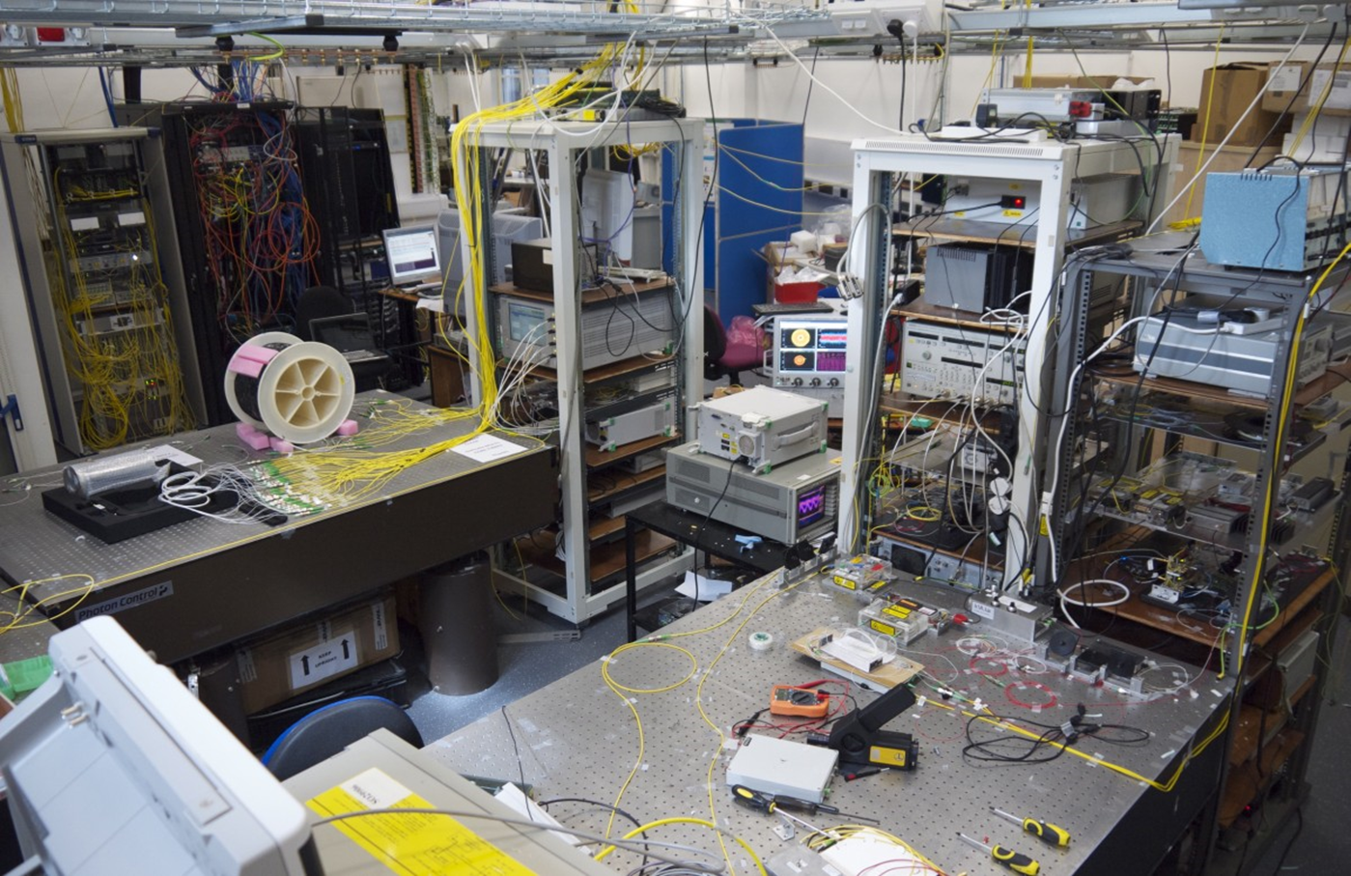
HPN Group/ University of Bristol
http://www.bristol.ac.uk/engineering/research/hpn/
HPN is one the UK’s most recognised network research centre
world leadership on open innovation
one of the largest experimental infrastructure including optical, 5G and Smart City networks
more than £80M of research grants over the last five years
collaborate with leading partners across the UK, Europe, USA, Brazil and Japan
strategic partnerships Nokia/BT/Bristol City council
Part of NDFIS network

Slide 7
Part 1
Introduction to modern optical networks
Session1: Introduction to modern optical networks
Session2: Fundamental optical network technologies and topologies

Slide 8
Introduction to modern optical networks
Optical Networks : Why?
What is an optical network
What is an optical communication link
Optical transmission and modulation techniques
Different types of optical network connectivity and topology

Slide 9
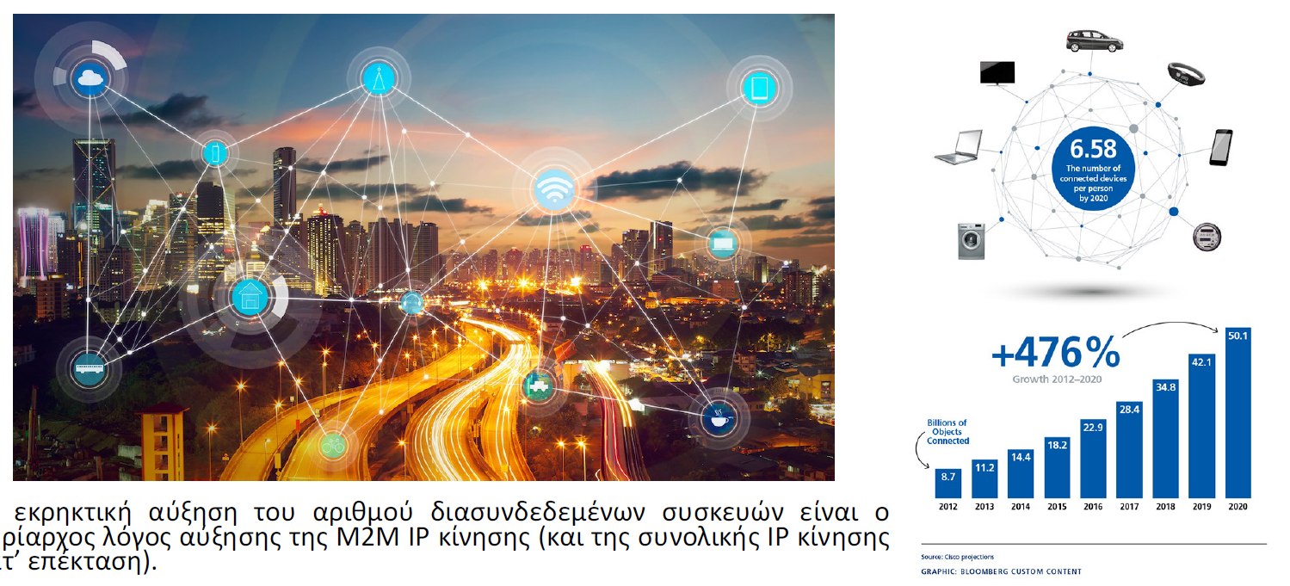
Internet of Things (IoT)
Number of interconnected devices drastically affects IP traffic
Notes:
items embedded with electronics, software, sensors, actuators, and network connectivity

Slide 10
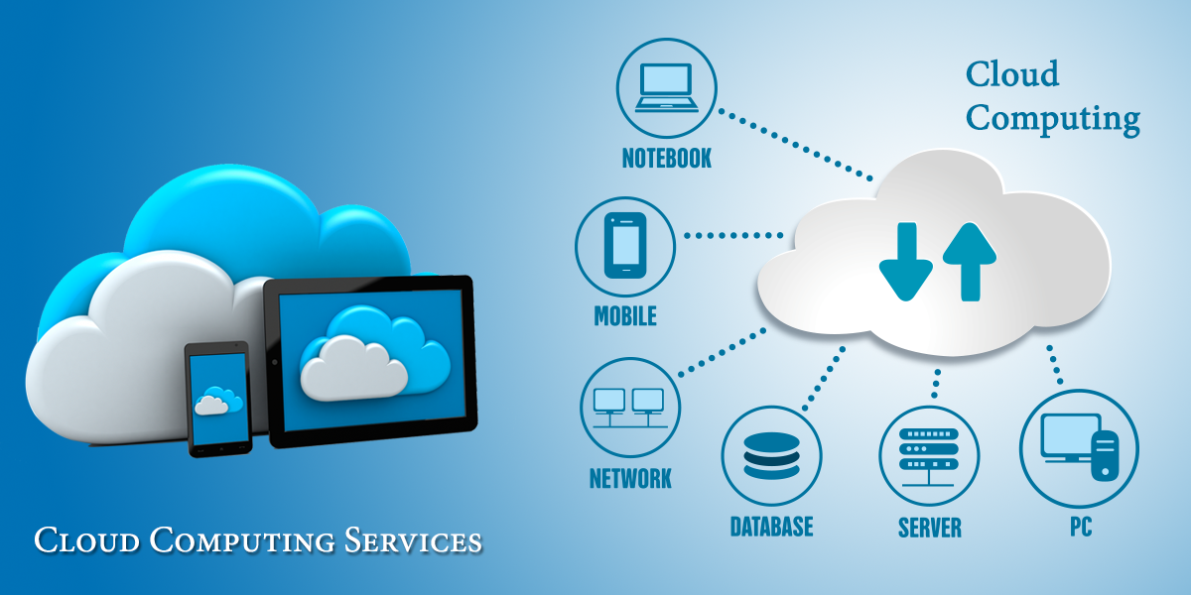
Cloud Computing
cloud computing means storing and accessing data and programs over the Internet
Notes:
You’re probably using cloud computing right now, even if you don’t realise it. If you use an online service to send emails, edit documents, watch films or TV, listen to music, play games, or store pictures and other files, it’s likely that cloud computing is making it all possible behind the scenes.
Top benefits of cloud computing
1. Cost
2. Speed5. Performance
3. Global scale
4. Productivity
6. Reliability
So who can think of CC applications?
https://azure.microsoft.com/en-gb/overview/what-is-cloud-computing/

Slide 11
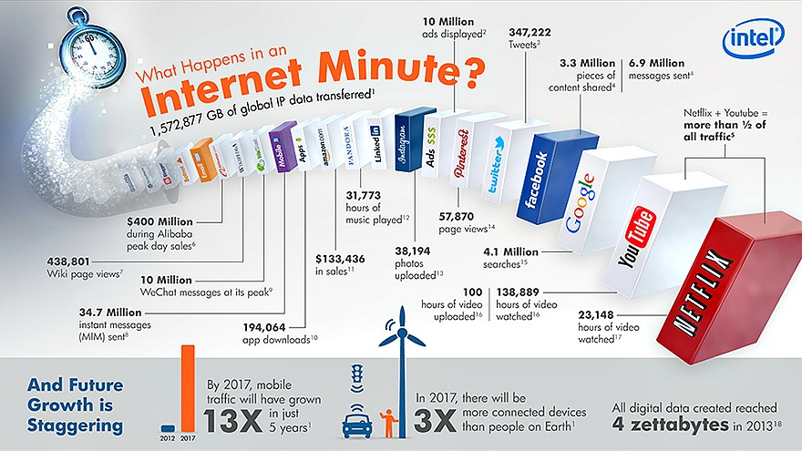
How cloud affects Internet traffic

Slide 12
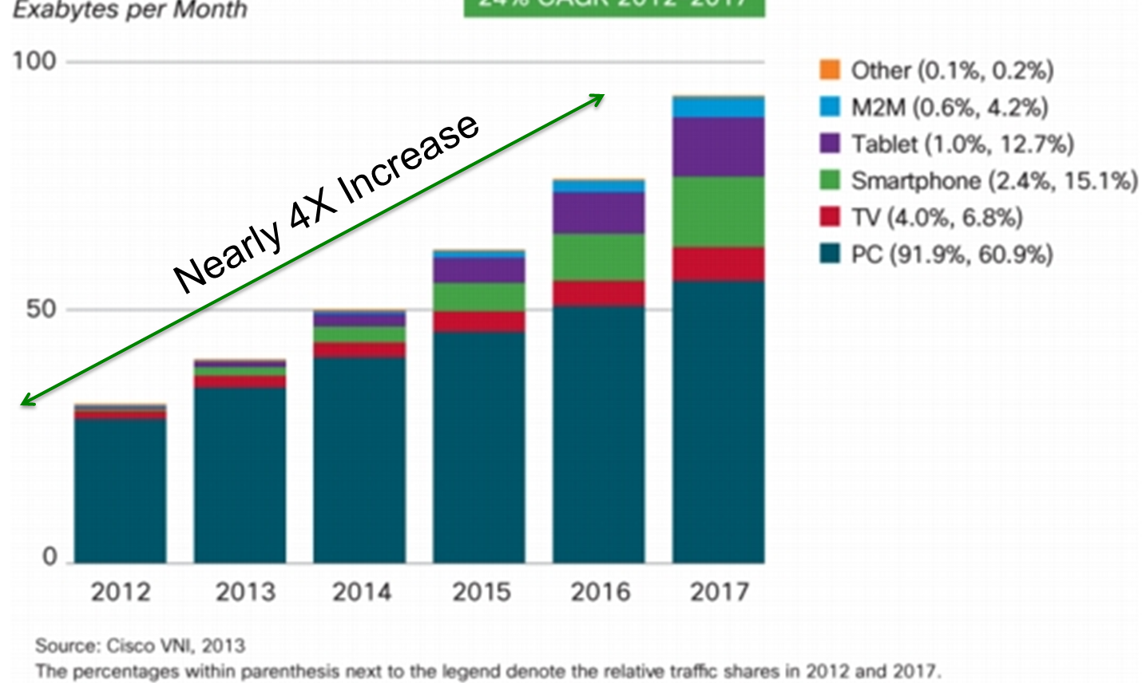
Global Internet traffic
Nearly 5X Increase
Cisco reveals an annual global Cloud-IP traffic growth of 21% to 7.4 ZB by the end of 2021 !!!!

Slide 13

Internet Network requirements
How internet really looks like
Bandwidth per connection is increasing:
from 155Mbit/s to 2.5/10Gbit/s even 40 Gbit/s
Total core bandwidth is increasing:
Reaching Zeta-byte per month by end of decade
High availability, full redundancy & fast recovery
Low latency for novel applications (autonomous cars, VR/AR, e-health etc)
Energy efficient
Low Cost: Network Providers to provide more services at higher capacity at lower prices!
A positive feedback business model!
More users
https://internet-map.net/
90% of internet are fiber-optic cables that carry the data around the world

Slide 14

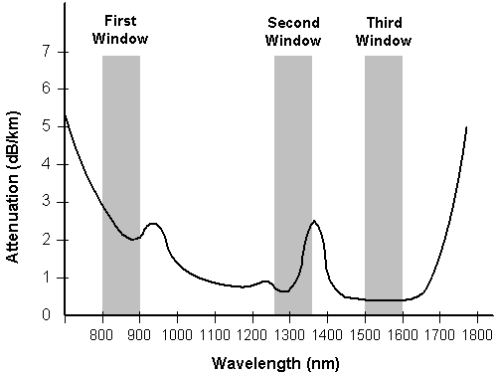
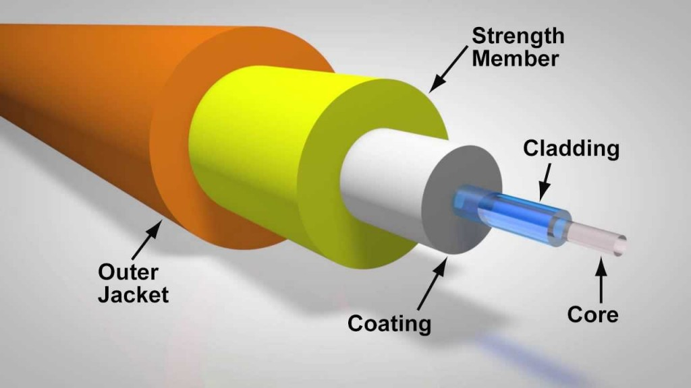
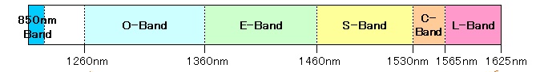
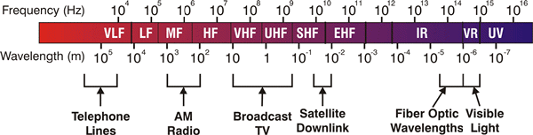
Optics Communications
Optical fiber to transmit light:
~ 90% of networks total cables length is optical fiber
~ light frequency: 193 THz
~ propagation losses: 0.2 dB/Km

Slide 15
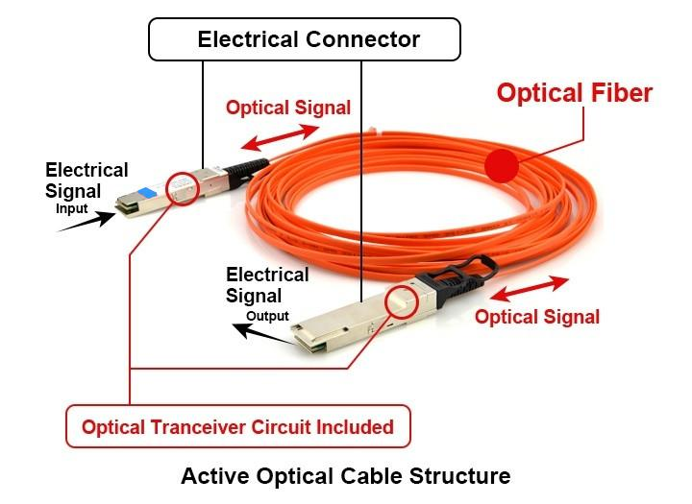
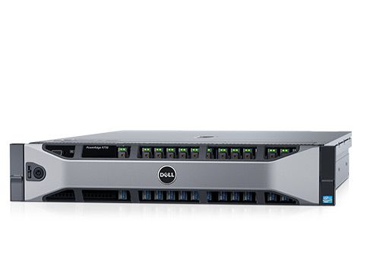
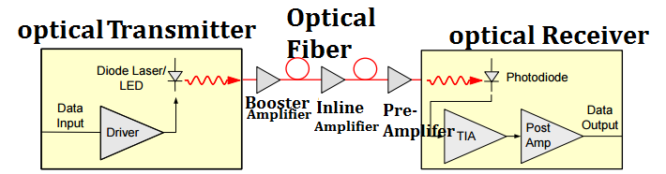
So how does this work?
Opto-Electronic Conversion

Slide 16
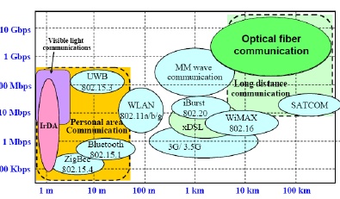
Why Optical Networking I – optics communications
Optical Communication systems:
Optical fibre is the most cost effective way to move huge amounts of information) quickly and reliably over long distances
Huge Bandwidth
Long Reach
Low loss
Cost effective
Secure links
Bandwidth x Distance product

Slide 17
Why Optical Networking II – advanced networks
Internet backbone network needs more than just simple high bandwidth point-to-point
Large number of different types of users
Application with heterogeneous bandwidth and service requirements
Delivery of bandwidth in minutes/hours and not days/months
Modern optical networks provide:
Dynamic allocation of connectivity and bandwidth
Routing and signaling of bandwidth connectivity
significant energy efficiency

Slide 18
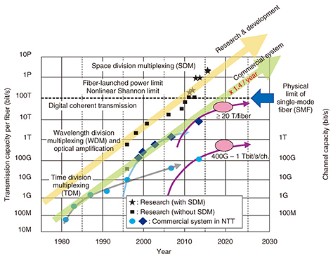
Optical transmission bandwidth evolution
NTT Review Report
State-of-the-art Space Division Multiplexing Technologies for Future High-capacity Optical Transport Networks

Slide 19
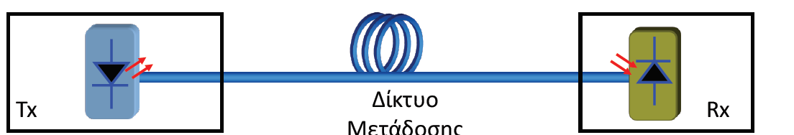
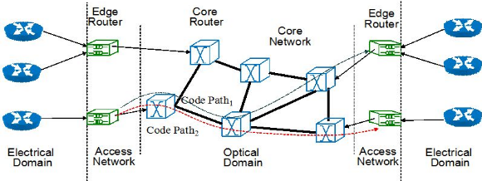
What is optical networking
Optical Communication System
Three basic components
Optical Transmitter
Optical Receiver
Optical Communication Channel
Optical Fibre
Optical communication channel
transmitter
receiver
Optical Network
Deploying optical communication system within context of a network topology
To build a network topology interconnecting multiple end points
Transmission, moving and routing data efficiently across the network

Slide 20
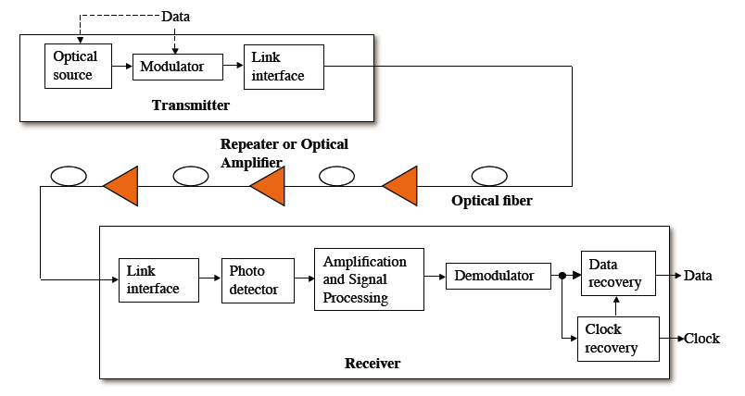
Optical communication link
Basic principle:
Amplifier [Regenerator]

Slide 21
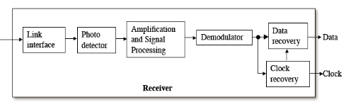
Key parameters of optical communication link
Channel:
Laser Optical Power
Wavelength(s)
Capacity:
Data Format
Line bit rate
Fiber:
Multimode/Singlemode/Multicore
Link power budget and losses
length
Amplifiers/Repeaters:
2R/3R regenerator
EDFA, SOA, Raman
Receiver:
PIN/APD - electrical output power
Sensitivity
Channel:
Noise level (OSNR)
Quality of Signal (Bit Error Rate)

Slide 22
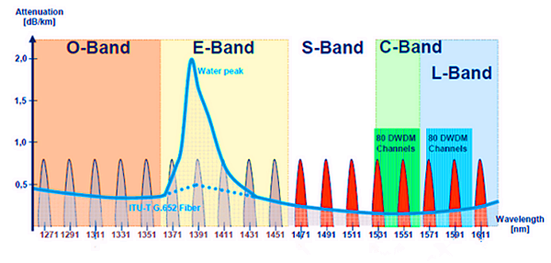
What is an optical carrier /channel/frequency/Lambda
Fibre attenuation
Windows of low loss in fibre
Channel rates
dB/km
Year 1980:
1 channel
year 1990:
2 channels
year after 2000:
> 50 channels
1.0
0.5
140 Mbit/s
λμ
1.3
1.5
/m
dB/km
1.0
0.5
2.5 Gbit/s
λμ
1.5
/m
dB/km
1.3
1.0
0.5
10/40/ Gbit/s
10/40/100/160/320 Gbps
λμ
1.3
/m
1.5

Slide 23
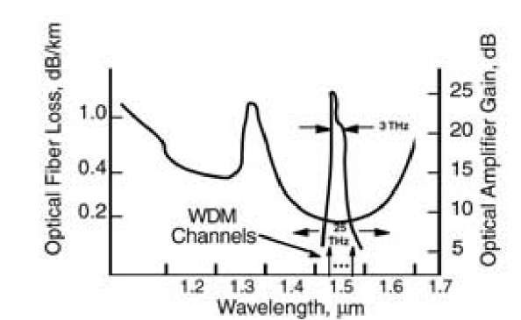
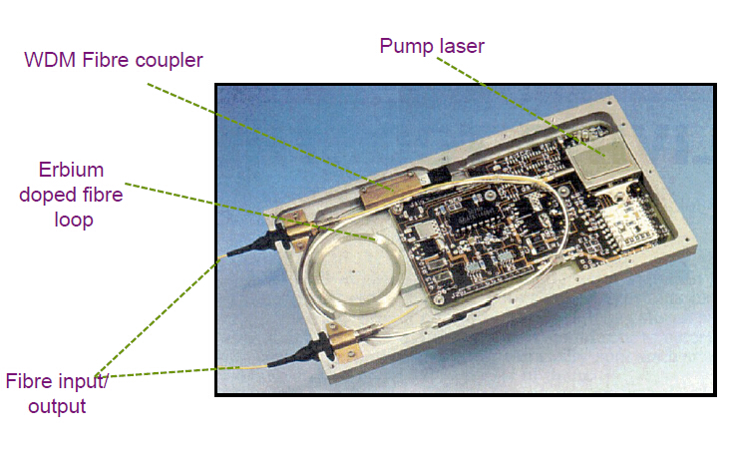
Information Bandwidth of Fibre
Around 1.55 μm carrier frequency there is a low attenuation range of 180 nm where light can be transmitted
Centered at 1.3 μm there is a low attenuation region of 80nm
Theoretical Upper bound BW ~ 25 THz
Amplifiers (EDFA) bandwidth
restricts available bandwidth to 4THz

Slide 24
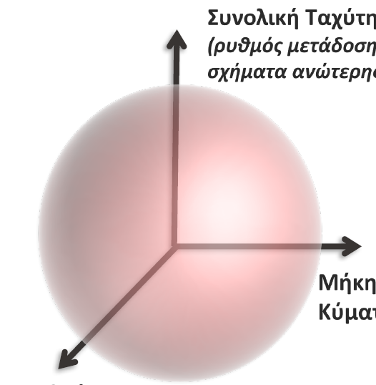
Multiplexing in optical communication
How to increase an optical communication link capacity
About 4THz of available bandwidth per amplified fibre
Install more fibers
Increase modulation bit rate
Use Multiplexing techniques
Bit rate/data format
More channels/
Wavelength multiplexing
More fibers/
Spatial multiplexing
Multiplexing is preferred choice and it is a networking technique
less complex and less expensive than other solutions
It can be used in combination with other techniques

Slide 25
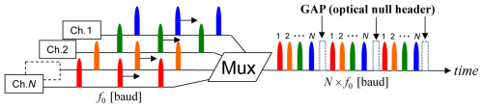
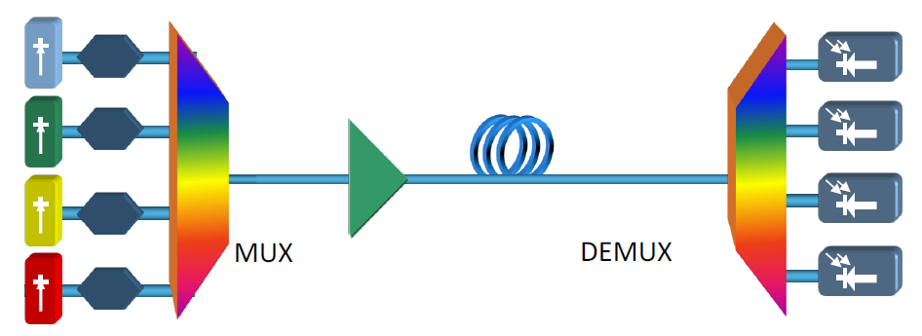
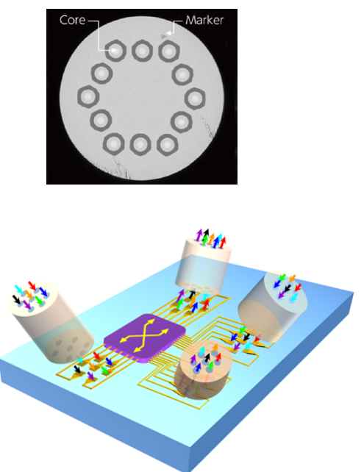
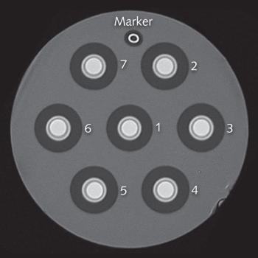
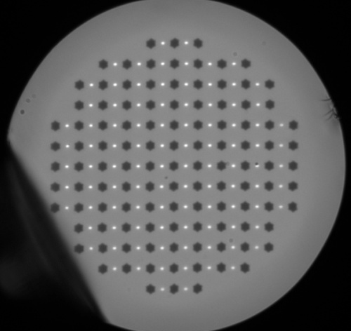
Key multiplexing formats of optical networks
Optical Time Division Multiplexing - OTDM
Wavelength Division Multiplexing - WDM
Light has different colours
Fundamental ability to parallelize
Spatial Division Multiplexing - SDM
Multicore fibers

Slide 26
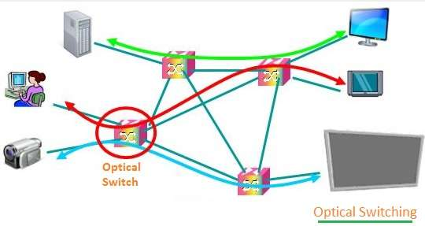
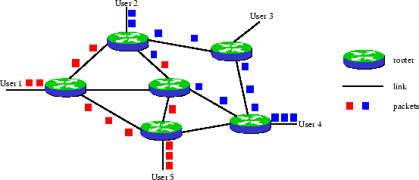
Switching/Routing in optical networks
Circuit switching
Packet switching

Slide 27
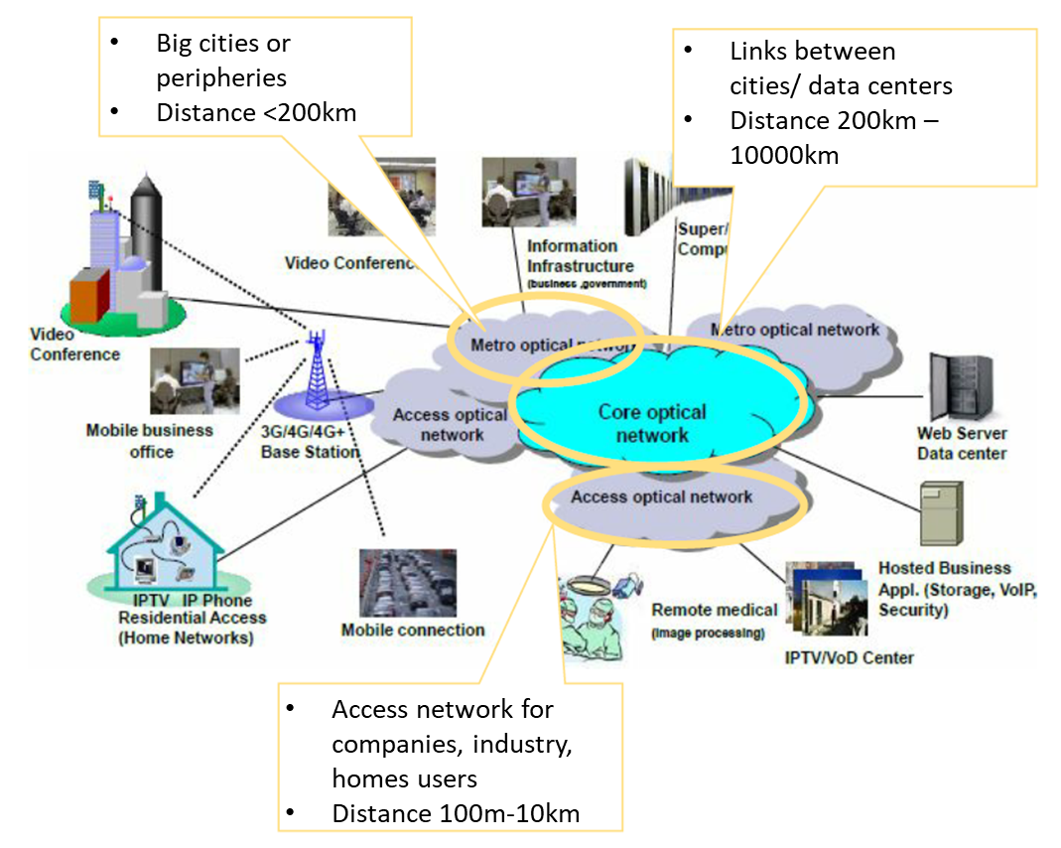


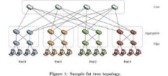
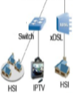
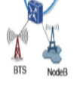
Optical networks hierarchy
Different optical fiber networks:
Bandwidth
Reach
Cost
Wide Area Networks (WAN)
or backbone/core networks
Metropolitan Area Networks (MAN)
Access Networks
Access Network
Metro Network
Core Network
Data Center

Slide 28
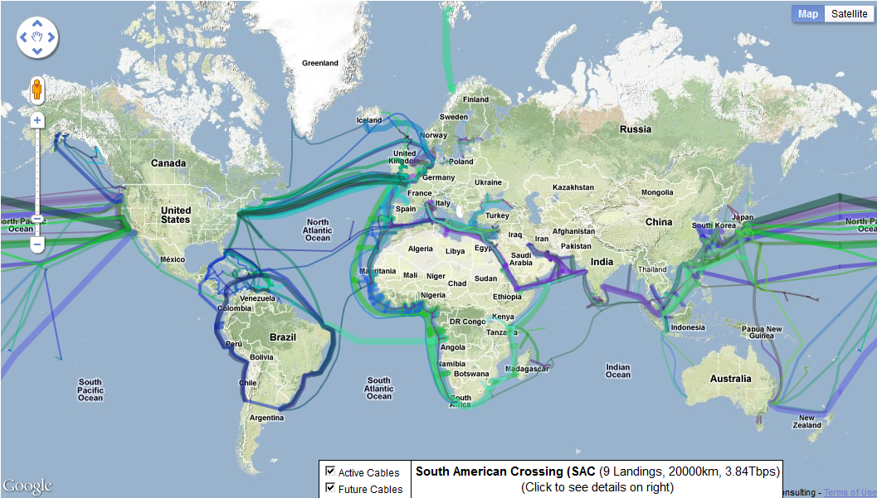
Core/Long Haul Networks
https://www.submarinecablemap.com/#/
From 2010, All continents connected (except Antarctica)
Point-to-Point links with WDM multiplexing (mesh networks)
Optical wavelength routing
Optical cross connects

Slide 29
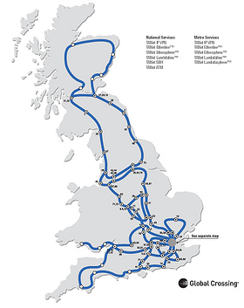
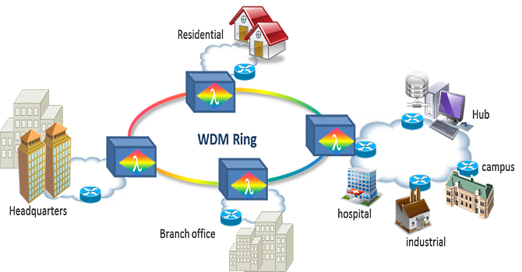
Metro Networks
Metro networks are national/city wide networks
WDM technology
Usually deployed as ring topology
Optical wavelength routing
Optical cross connects

Slide 30
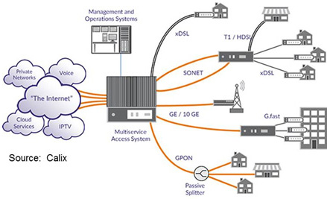
Access networks
point to point links: Active optical networks
Central Office to end users
Star topology: Passive Optical Networks – PON
Optical Line Terminal - OLT to optical network units - ONU
No active optical devices (switches, amplifiers), only splitters

Slide 31
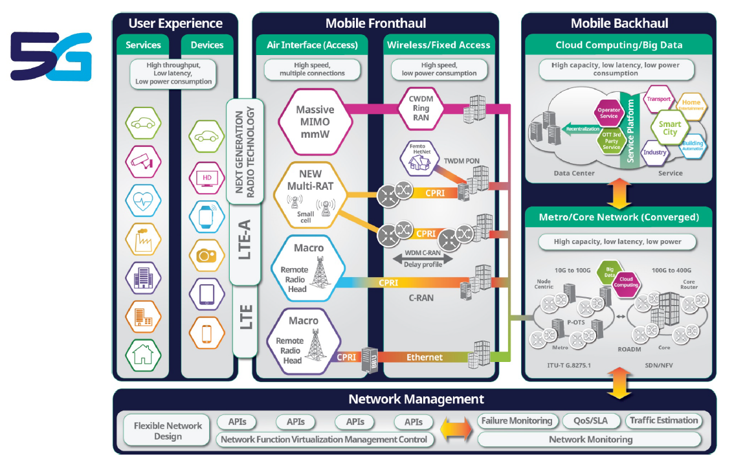
Next Generation Networks

Slide 32
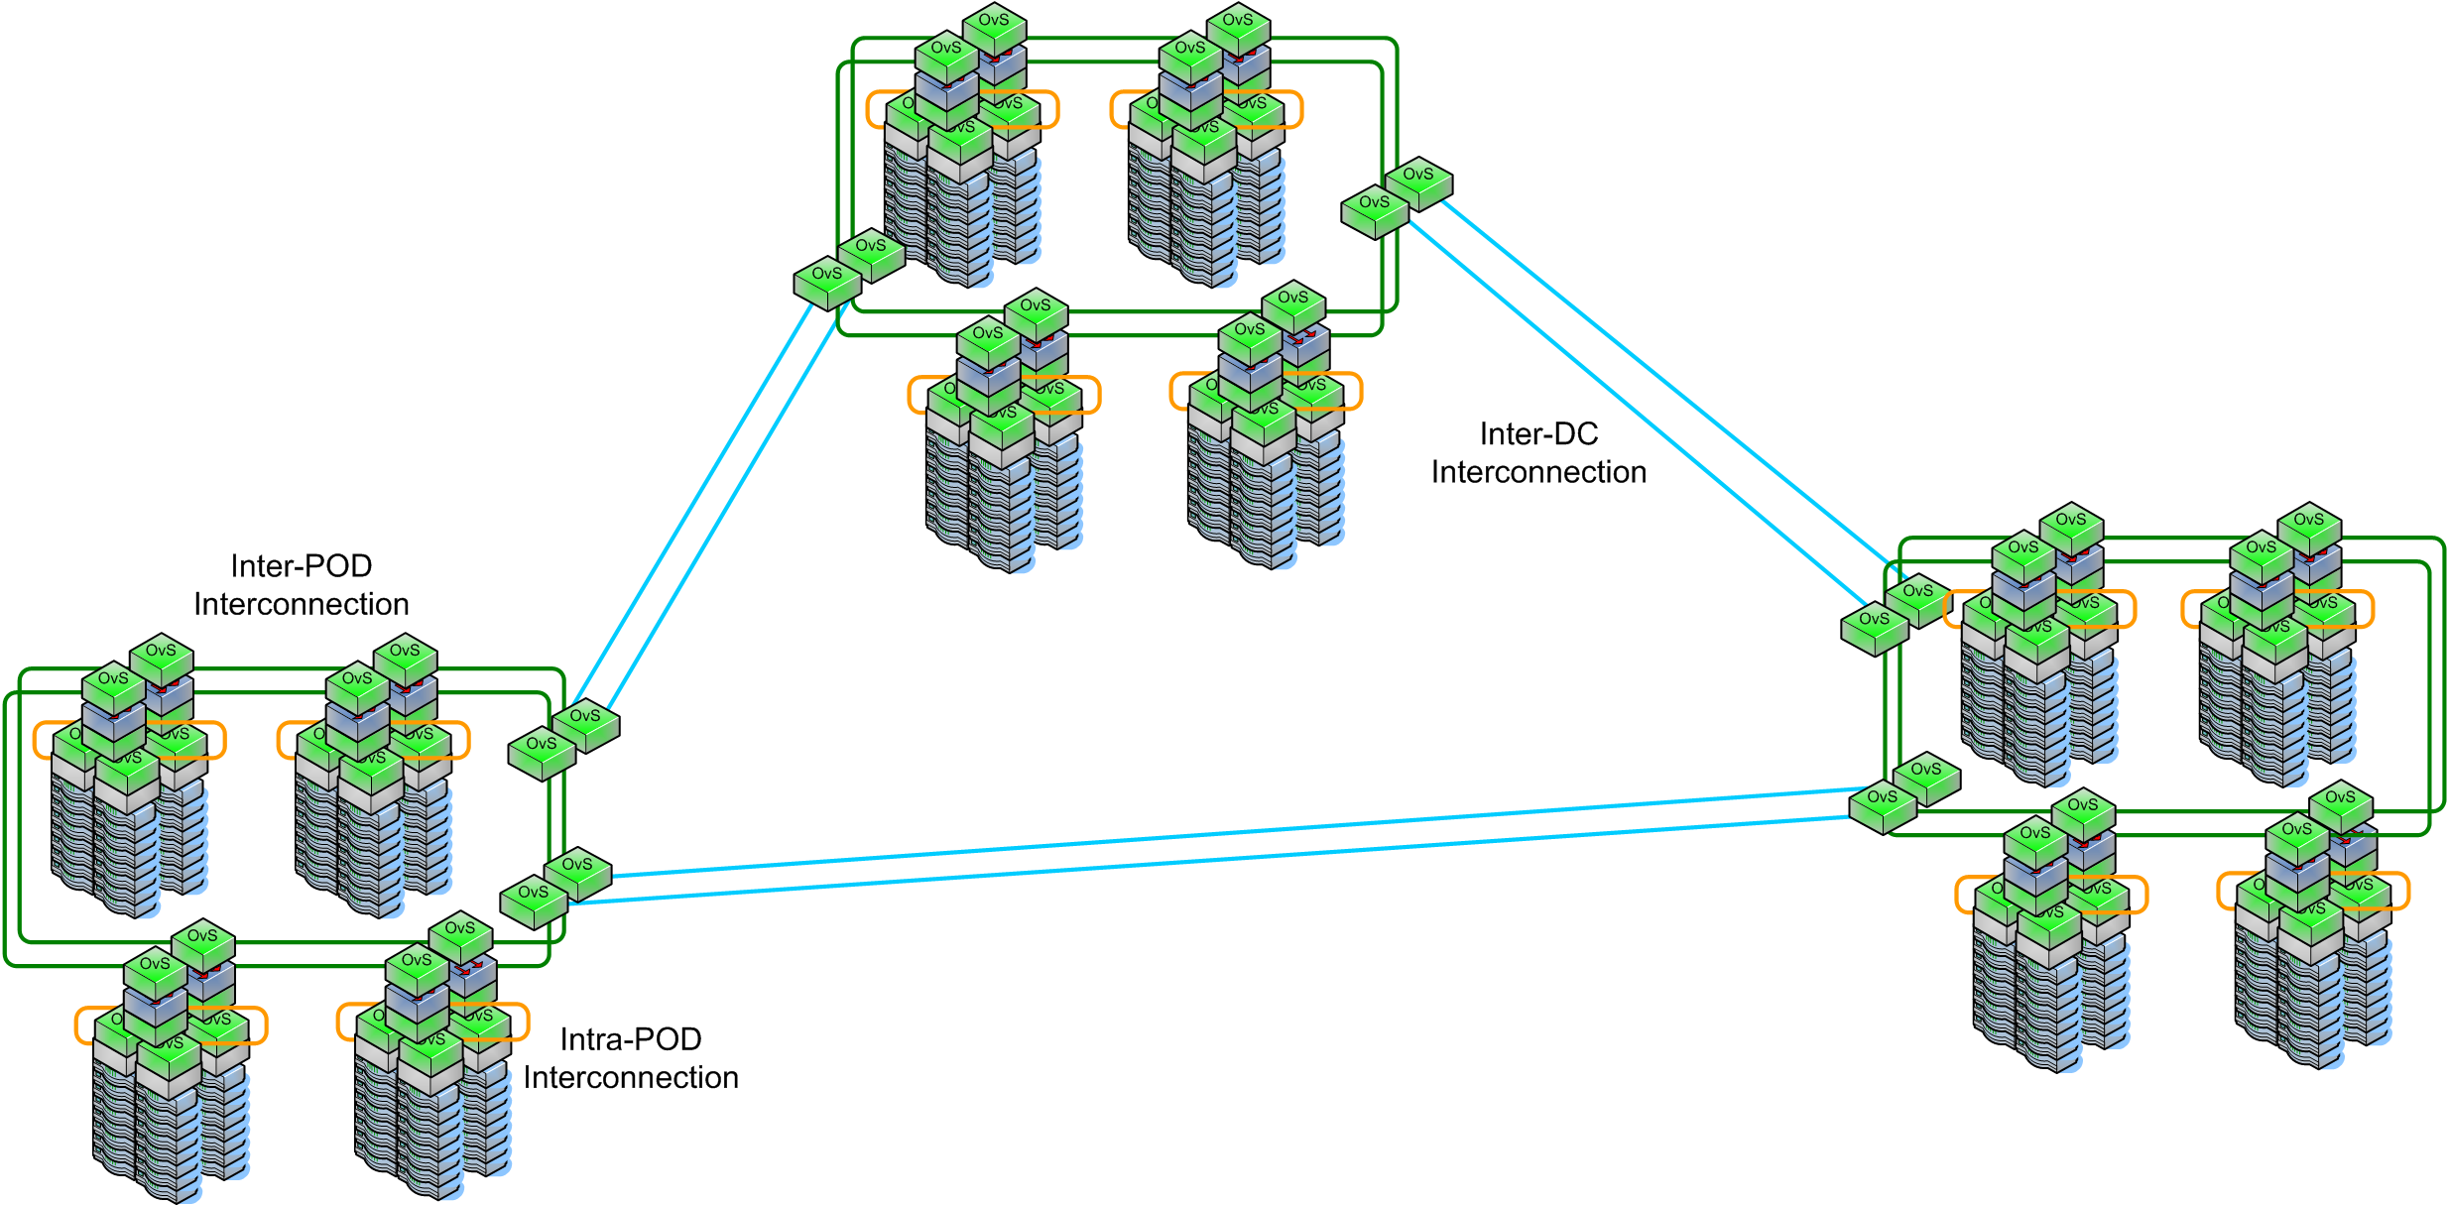
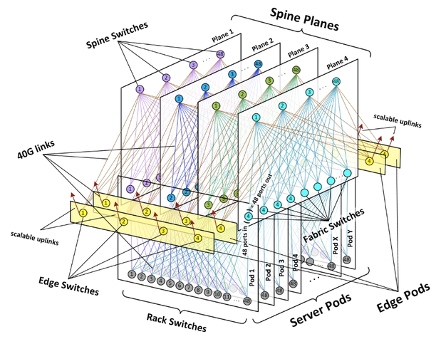
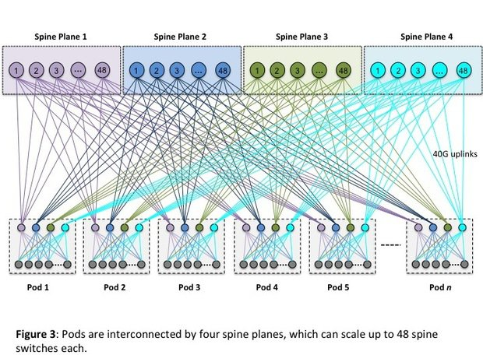
Data Center Networks
Inter-DC networks
Intra-DC networks

Slide 33
End of session 1
Any questions?

